Slide 1
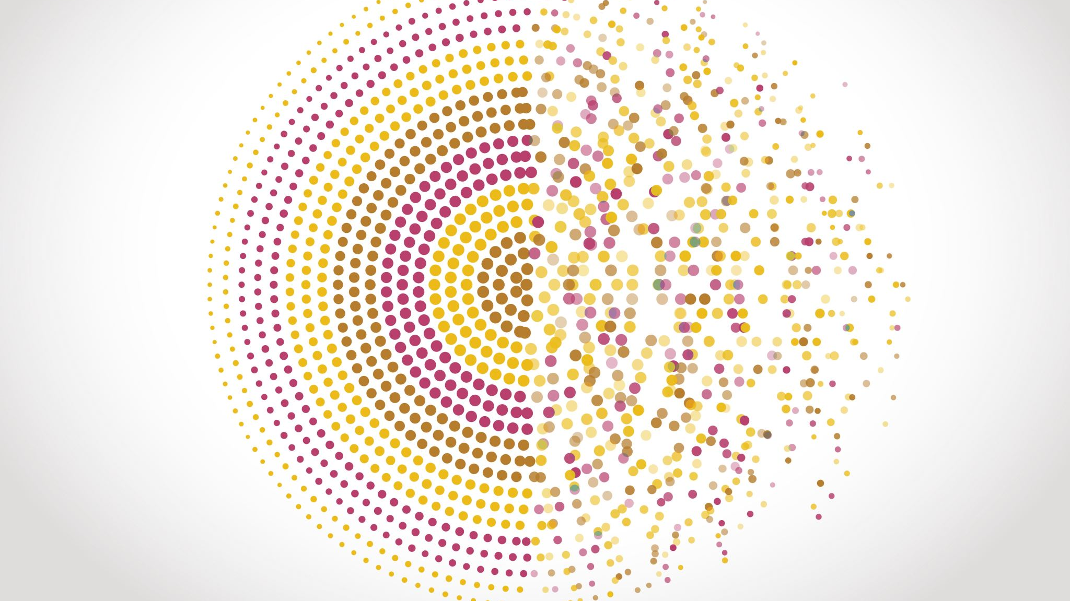
Sentiment Analysis
Using Recurrent Neural Networks

